Slide 1
Intro to workflows

Slide 2
If you don’t understand something
It’s my fault
bad explanation
good explanation but targeting wrong audience
good explanation, targeting correct audience, but too much all at once
Please feel free to interrupt with questions! I’ve tried to simplify, but I’ve been doing this stuff for very long.

Slide 3
Overview
Session 1: basics of installing and running software on the command line
Session 2: running command line programs with snakemake
Session 3: snpArcher
Sessions become increasingly specialized, especially the 3rd one

Slide 4
Session 2
Running command line programs with snakemake helps automate
running the same program on many files, collecting results
e.g. for many samples for same species, or many species
running many programs in serial, potentially on many files

Slide 5
Session 3
snpArcher
a specific snakemake workflow for automating SNP detection in WGS data
If you’re not working with WGS data, this session likely won’t be useful

Slide 6
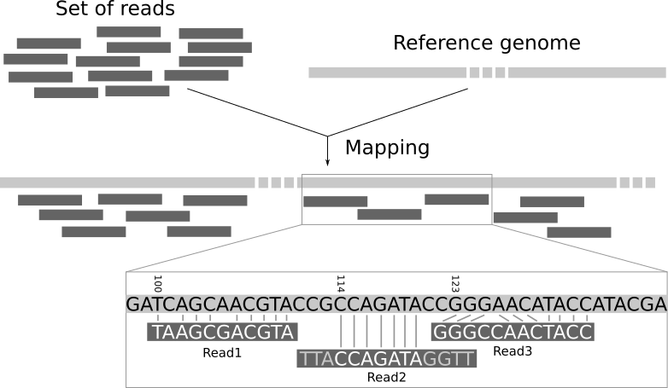
WGS summary: finding mutations
Sequencing a genome to detect mutations in each sample involves the following steps:
In the lab:
extracting the DNA from thousands of cells
breaking the chromosome DNA into tiny fragments 300-500bp long
sequencing each of the tiny fragments
On the computer
clean the raw data consisting of tiny DNA sequences
aligning these DNA sequences to larger chromosome-sized pieces, from a “reference” genome available from the same species
finding mutations that are supported by many sequencing reads
sequencing reads from many different cells
or aligning
this requires multiple steps, done in serial, in a ‘computational workflow’
reference = C
sequencing read = A

Slide 7
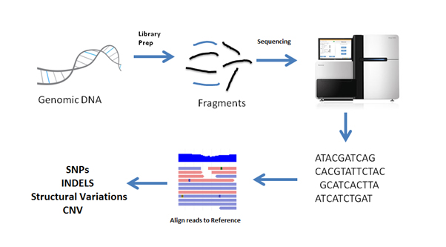
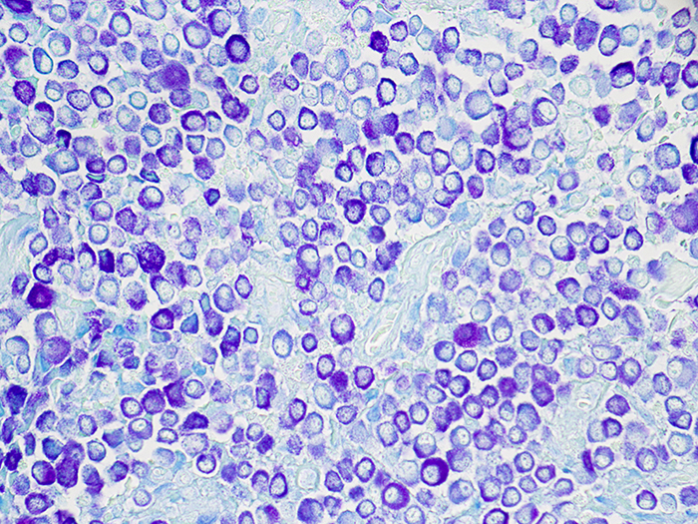
WGS summary: workflow
generic key takeaways:
data needs to be processed in many steps
output of step n is input of step n+1
each step involves a different program
if you have data for 100’s of samples, you must do this 100’s of times, so organized + automated is best!
extract DNA
give to sequencer
shear
DNA fragments
file type
RAW
FASTQ
CLEANED
FASTQ
BAM
deduplicated
BAM
VCF
Clean raw data
Align sequencing reads
Clean
BAM
file
Find mutations
analyzing this file typically answers evolutionary questions
step in pipeline
Notes:
This is a high-level overview to show what we’re about to go through. Things probably don’t make sense at this point, but we will go through each one of these steps individually.
Regardless of what analyses you want to do with your DNA sequences, chances are you’ll have to do all these steps
Things in boxes are kinds of files, or file types
Things between file types describe what gets done to go from one file type to another file type
FASTQ is derived from FASTA, with an added Q to represent “quality”
BAM stands for binary aligned map
VCF stands for variant call format

Slide 8
Brief description of file types

Slide 9
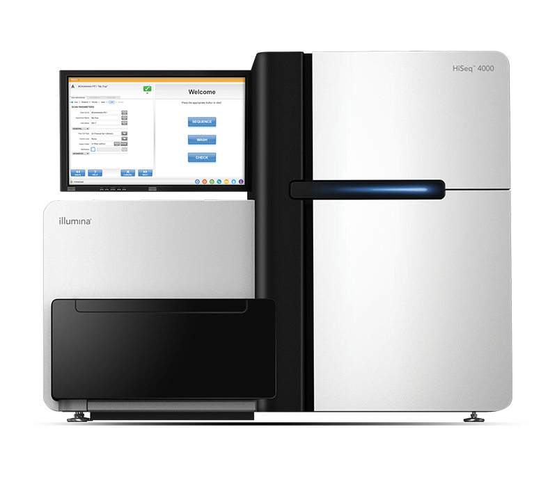
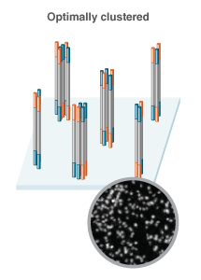
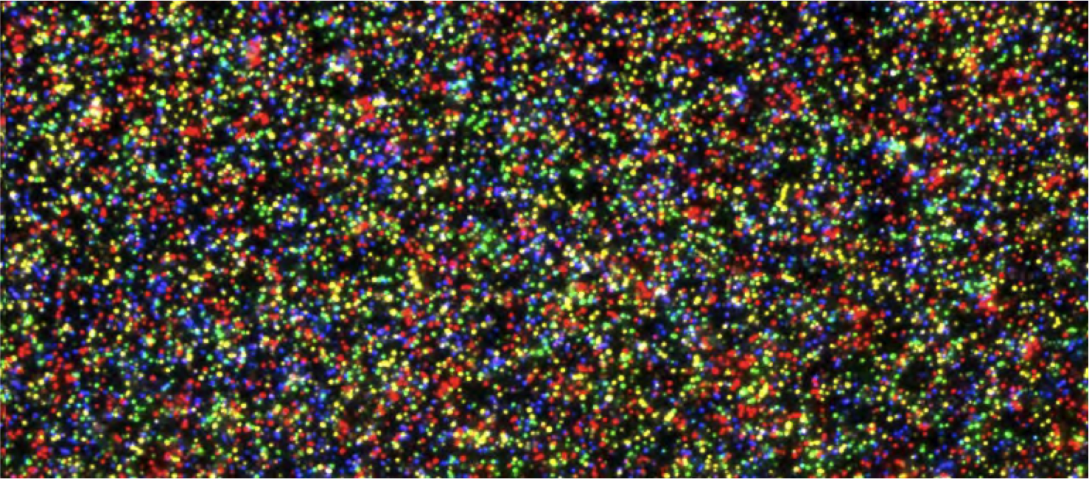
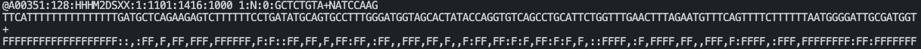
FASTQ file
Colors are converted to nucleotides in a FASTQ file!
Here’s one entry of a FASTQ file (typically there are millions):
4 lines per sequencing read
identifier
DNA sequence
some separator
base quality scores (coded using ASCII characters to represent numerical scores)

Slide 10
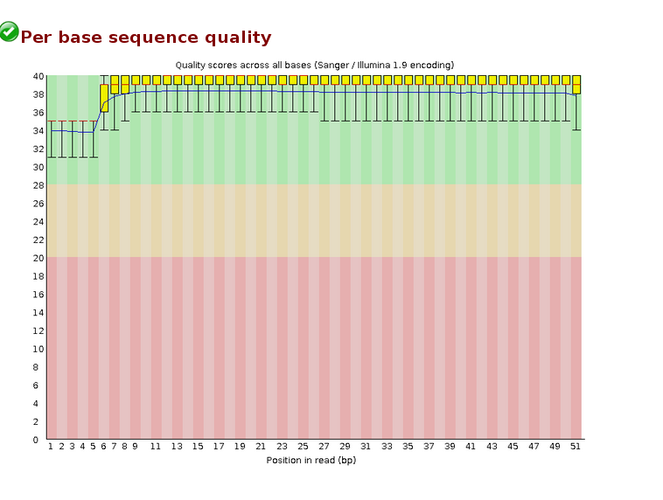
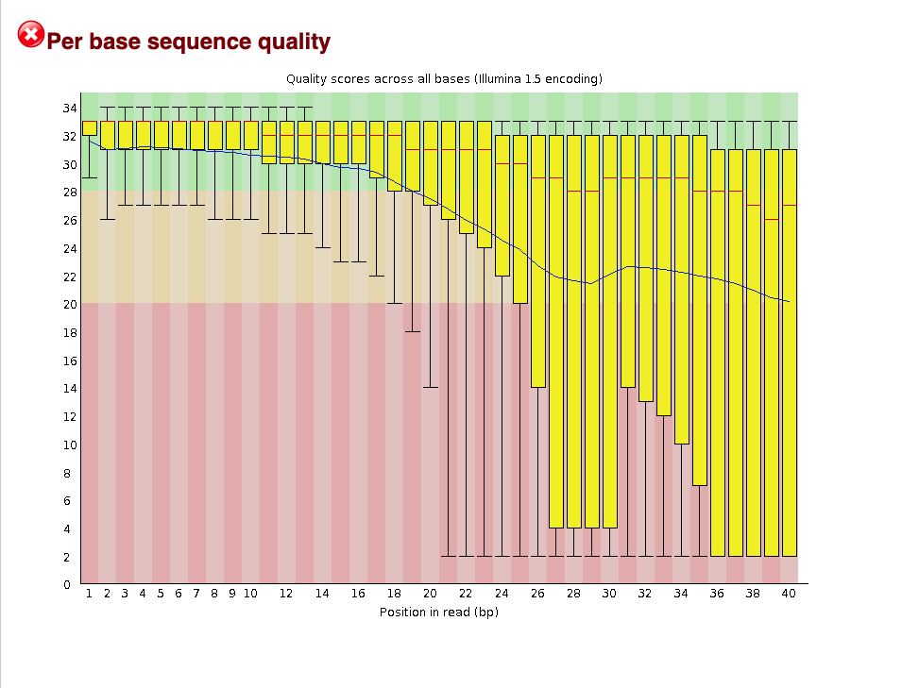
CLEANED FASTQ: throw away bad data
Each nucleotide in FASTQ has a quality score
trim nucleotides from reads
Illumina adapter sequences
poly-A tails (if RNAseq data)
low quality nucleotides at end of reads
discard entire reads that have many low quality nucleotides
Good programs:
fastp
fastqc
Notes:
In genomics, you typically generate a TON of data, and then throw out some data. Don’t be scared to throw away low quality data. Everyone does it, and it makes life easier afterwards.
It’s best practice to filter out low quality reads, but mapping alrogithms also take base quality into account, and are capable of clipping your reads at places where there’s absolutely no match, i.e. poly A taiol or illumina adapter
images from
https://www.neb.com/en-us/tools-and-resources/feature-articles/the-quantitation-question-how-does-accurate-library-quantitation-influence-sequencing
https://depts.washington.edu/molmicdx/mdx/tests/NGS16S.shtml

Slide 11
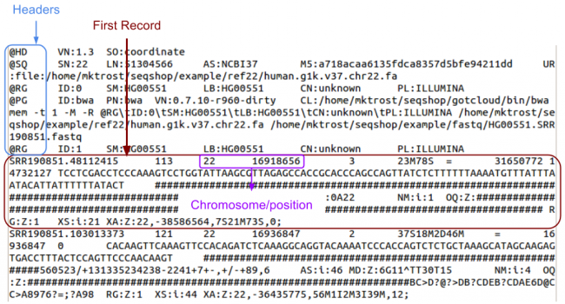
BAM file: reference genome alignment
aligned reads to a known reference genome
best if reads and reference genome are from the same species
Otherwise, hard to find similarities b/t reads and reference!
some programs specialize in aligning to diverged reference
Good programs:
BWA (short reads), minimap2 (long reads)
Reads get aligned best on similarity to positions in reference genome
Notes:
images from:
https://training.galaxyproject.org/training-material/topics/sequence-analysis/tutorials/mapping/tutorial.html

Slide 12
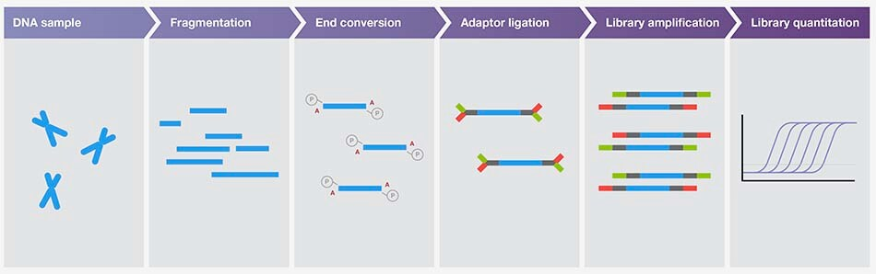
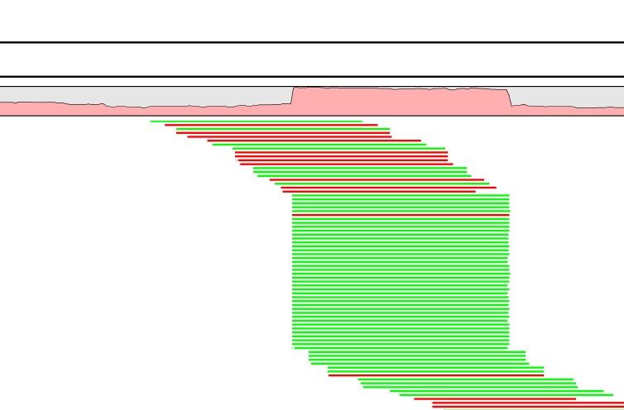
BAM deduplicated: throw away more bad data
mark PCR duplicates
Preparing DNA for sequencing
most analyses assume short DNA fragments (~500bp) have been randomly sampled across the genome
in many DNA preparation protocols, there is a PCR step to
enrich DNA fragments with adapters
increase amount of DNA
introduce extra barcodes to the ends of DNA to track samples
PCR duplicates should be identified so downstream programs are aware of them!
Good programs:
picard
sambamba
PCR duplicates align w/ identical start/stop positions, all same molecule that was duplicated!
Notes:
images from:
https://training.galaxyproject.org/training-material/topics/sequence-analysis/tutorials/mapping/tutorial.html

Slide 13
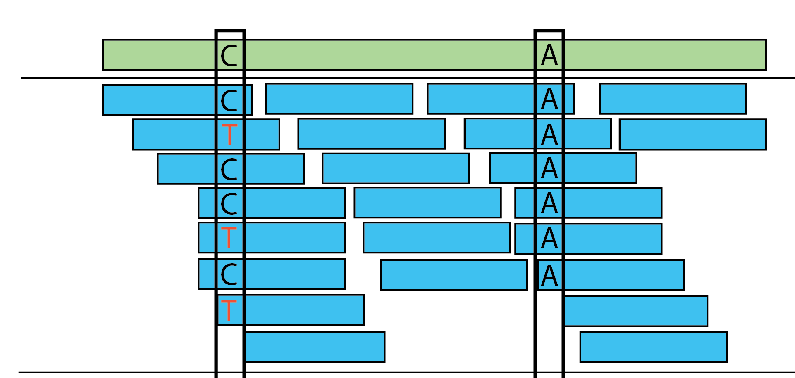
VCF file: variant calling
Reference genome
use reference-aligned reads to detect single nucleotide polymorphisms (SNPs)
nucleotides that differ from the reference genome sequence
Good programs:
GATK4 (gold standard but painful to use)
freebayes
Sequencing reads
looks like a C/T heterozygote
Notes:
images from:
https://hbctraining.github.io/variant_analysis/lessons/09_variant_calling.html

Slide 14
See ‘01_fastq_2_vcf_workflow’ for an example

